Slide 1
Practice
Let's try to make it.

Slide 2
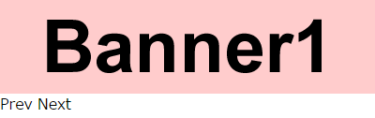
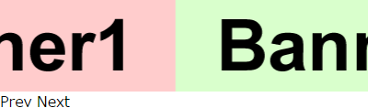
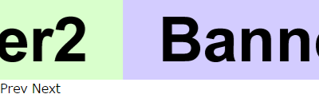
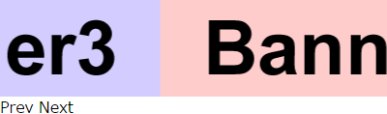
Practice
Make carousel slider
Action
Preparation
<div class="carousel">
<ul class="carouselList">
<li><img src="img/banner1.gif" width="400" height="100" alt="Banner1"></li>
<li><img src="img/banner2.gif" width="400" height="100" alt="Banner2"></li>
<li><img src="img/banner3.gif" width="400" height="100" alt="Banner3"></li>
</ul>
</div>
<div class="navi">
<span class="prev">Prev</span>
<span class="next">Next</span>
</div>
Slide from the right by Next click
Thinking point
How do you make it move
⇒ Operate CSS by jQuery
How do you implement end processing
⇒ Copy element
⇒ Management current location
※ There are several implement method. So, refer to just one of example.
First banner slide from the right by Next click on the end of banner

Slide 3

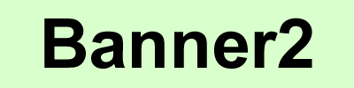

Practice
Copy element
Set banners in side by side by CSS to show only one banner.
If it is like this, it can not show anything when you move on both ends.
Therefore, set element copy on both ends.
Use clone() for copy.
Make a clone of the element and add it to specified location.
var list = $(".carouselList"),
item = $(".carouselList li"),
itemLength = item.length;
// Copy the first, and add it to the end
item.eq(0).clone().appendTo(list);
// After copying the second later because copy is set in the end
// And add it to the head
item.eq(itemLength - 1).clone().prependTo(list);

Slide 4
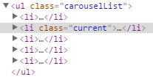
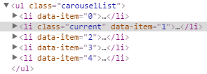
Practice
If you show it by a browser, it becomes like this.
Original banners are three. However, they become five because they are copied.
<ul class="carouselList">
<li><img src="img/banner3.gif" width="400" height="100" alt="Banner3"></li>
<li><img src="img/banner1.gif" width="400" height="100" alt="Banner1"></li>
<li><img src="img/banner2.gif" width="400" height="100" alt="Banner2"></li>
<li><img src="img/banner3.gif" width="400" height="100" alt="Banner3"></li>
<li><img src="img/banner1.gif" width="400" height="100" alt="Banner1"></li>
</ul>
Put structure to search current showing location in after implement.
Then, give class name to the current location.
var c = "current";
item.eq(0).addClass(c);
Even though we specified eq(0) to first of "item", class is given to the second.
Variable item does not point new $(".carouselList li") ,
object that specified firstly is stored.
You can not use it later, so you need to get the item again.
item = list.children();
Put number for it to be easy to understand what is a number when it searches current location.
Use unique data attribute （data-*）.
var i = 0;
item.each(function () {
$(this).attr("data-item", i);
i++;
});

Slide 5
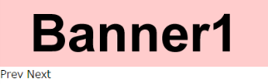
Practice
Adjust display position
You can write it by CSS firstry. However, get number and width by JavaScript to coorespond when number of banner change.
var itemWidth = item.width(); // Get width of one banner
Specify display frame part CSS.
var view = $(".carousel");
view.css({
"width": itemWidth,
"height": item.height()
});
Specify list part CSS. Adjust the whole length and display location.
If you move it -400px from a standard location of the left side, it locates on Banner1.
var view = $(".carousel");
list.css({
"width": itemWidth * item.length,
"transform": "translate(-" + itemWidth + "px, 0)"
});
The number after copying
How to write that combine string and variable
Default display completed.

Slide 6
Practice
Next click
Write processing when you click.
var next = $(".next");
next.on("click", function () {
// Write processing when you click.
});
Get current location.
Get data-item attribute value of the element that has class name "current".
If it is first Next click, 1 is stored in n.
Next location add 1 and it is 2.
var n = 1;
item.each(function () {
if ($(this).hasClass(c)) {
n = $(this).data("item");
}
});
n = n + 1; // Move current location to the next
You need to move it -800px (it is for two banners) to show Banner2.
Make a formula to become -400px * 2.
var distance = itemWidth * n;
Move it.
list.css({
"transform": "translate(-" + distance + "px, 0)",
"transition-duration": "1s"
});

Slide 7

Practice
Move current location class name "current".
Delete class name at once and give class name to the next location.
item.removeClass(c);
item.eq(n).addClass(c);
Summarize content so far and let's try to operate it on the browser.
It must slide smoothly like Banner1, Banner2, Banner3, Banner1.
However, after the last Banner1 is blank.
The last Baanner1 was copied to avoid a blank.
Put determination processing in this part and think a process for back to the first Banner1.
After it shows to the last, change location
A number of item is stored in variable firstly.
If the current location is bigger than the number, it can determine that it move to the end.
if (n > itemLength) {
// Write processing after showing the end
}
Move it to a default location.
Let's operate it on a browser.
It back to the head, however, animation from Banner3 to Banner1 must disappear.
JavaScript implements next line script without CSS animation completing. It is a feature of JavaScript.
It overwrites default location CSS soon after writing CSS of moving to the end. So, moving to the end disappeared.
list.css({
"transform": "translate(-" + itemWidth + "px, 0)",
"transition-duration": "0s"
});
item.removeClass(c);
item.eq(1).addClass(c);
Change quickly without animation

Slide 8
Practice
So, put processing that delay implement criterion formula by one second.
Put criterion formula in setTimeout and operate it on a browser.
You can confirm to change it to default location CSS when showing the end animation complete.
Next click processing complete.
setTimeout(function () {
// Implement one second later
}, 1000);
Complement
You also need processing that can not click during moving. However, we do not explain it.
So, confirm complete source in the last.
Prev click
Write processing by same thinking with Next.
The following are different points with Next.
Moving current location is -1, not +1.
When current location is 0, the end is determined.
Move to Banner3 after the determination.
Let's write it by yourself.
var next = $(".prev");
prev.on("click", function () {
// Write processing when you click.
});

Slide 9
Practice
Completion sample
$(function () {
"use strict";
// Default setting
var view = $(".carousel"),
list = $(".carouselList"),
item = $(".carouselList li"),
c = "current",
i = 0,
itemWidth = item.width(),
itemLength = item.length,
next = $(".next"),
prev = $(".prev"),
clickNav,
move;
// Before and behind clone
item.eq(0).clone().appendTo(list);
item.eq(itemLength - 1).clone().prependTo(list);
item.eq(0).addClass(c); // Default location
item = list.children(); // item renewal
// Numbering
item.each(function () {
$(this).attr("data-item", i);
i++;
});
// Specify size
view.css({
"width": itemWidth,
"height": item.height()
});
list.css({
"width": itemWidth * item.length,
"transform": "translate(-" + itemWidth + "px, 0)"
});
// Navigation click
clickNav = function (elem, n) {
elem.on("click", function () {
move(n);
});
};
clickNav(next, 1);
clickNav(prev, -1);
// Moving slide
move = function (i) {
// Delete event
next.off("click");
prev.off("click");
var n = 1, distance;
item.each(function () {
if ($(this).hasClass(c)) {
n = $(this).data("item");
}
});
n = n + i;
distance = itemWidth * n;
list.css({
"transform": "translate(-" + distance + "px, 0)",
"transition-duration": "1s"
});
item.removeClass(c);
item.eq(n).addClass(c);
setTimeout(function () {
if (n > itemLength) {
list.css({
"transform": "translate(-" + itemWidth + "px, 0)",
"transition-duration": "0s"
});
item.removeClass(c);
item.eq(1).addClass(c);
} else if (n === 0) {
list.css({
"transform": "translate(-" + itemWidth * itemLength + "px, 0)",
"transition-duration": "0s"
});
item.removeClass(c);
item.eq(itemLength).addClass(c);
}
// Reset event
clickNav(next, 1);
clickNav(prev, -1);
}, 1000);
};
});

Slide 10
Introduction to jQuery
2016年4月18日 発行
発行 トランスコスモス株式会社
執筆 DEC統括 WIS本部 事業戦略部 センターマネジメント課
※本テキストは、トランスコスモス（株）の社内情報も記載しております。
取り扱いには十分に注意してください
※本テキストの一部または全部を無断で使用、複製することを禁止します。

